Slide 1
Baseball Playoff Predictions
Modeling MLB team playoff chances based on team statistics and attributes
Author: Joshua Lensing

Slide 2
Business Problem
Professional baseball teams are increasingly using data and analytics to generate better in-game success.
The idea of “Moneyball” can be used to create teams using ambiguous statistics without an expensive payroll.
Making the playoffs creates a more successful franchise and adds value to the team and casting a wider market.
Teams need to know which combination of players will yield the best on-field results, leading to scoring runs and making the playoffs.

Slide 3
The Dataset
This dataset focuses mainly on offensive statistics, including batting average, runs scored, on-base percentage, and slugging percentage. It also includes runs allowed.
Teams from the entire MLB are used from 1962-2012. The number of wins during that season are recorded and if that team made the playoffs or not.
Making the playoffs is the target of the dataset. Predicting a playoff-bound team using the given statistics allows teams to assemble players that are projected to collectively reach or pass those numbers.

Slide 4
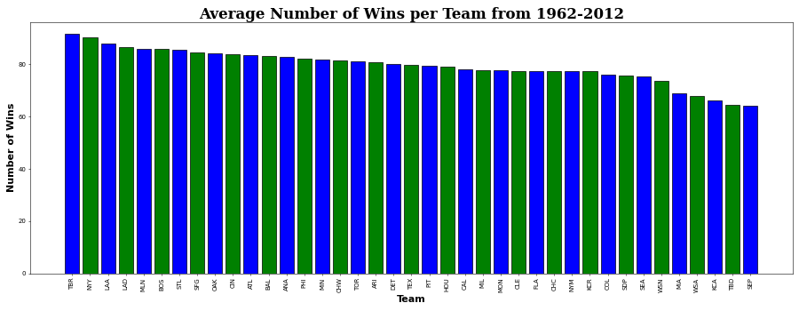
Visualizing Team Success
The average wins by teams from 1962-2012 shows the most successful teams during that time period. These teams found a recipe for success in order to win baseball games, and more than likely making the playoffs quite a few times by combining high on-base and slugging percentage.

Slide 5
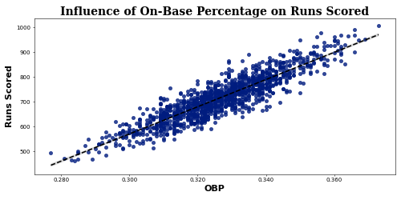
On-Base Percentage and Runs Scored
Scoring runs, and scoring a lot of them, is essential to winning baseball games. And a big factor in scoring runs comes from having a higher on-base percentage, giving the team more scoring opportunities.

Slide 6
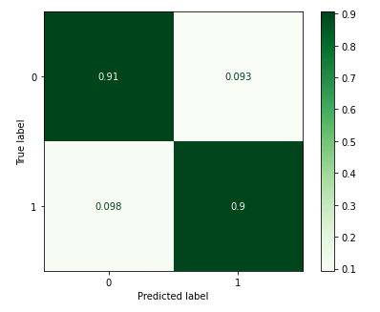
Strengths of Chosen Model
The model chosen had a recall score of 0.90, which means that the model was able to correctly predict a playoff team 90% of the time.
The recall score for non-playoff teams gave a 91% chance of the model correctly predicting teams that would not make the playoffs.
The error rates for incorrectly predicting playoff and non-playoff teams was about 10%. In a game filled with many outcomes, the ability to correctly predict if a team can or cannot make the playoffs 90% of the time can greatly help contribute to building a team with the right players.
Confusion Matrix for Prediction Scores

Slide 7

Model Limitations
Pitching stats were not included in the dataset. A more complex dataset may help improve the model’s ability to predict playoff teams.
The number of teams that make the playoffs are far lower compared to those that don’t, which is the nature of the sport. The large imbalance limits the model to predict with the same accuracy for playoff and non-playoff teams.
The stats for playoff teams differ from year to year, depending on the success of the top teams. This also limits the model’s ability to learn which stats lead to playoff teams.

Slide 8
Recommendation
The model I recommend to use for predicting making the playoffs is a Logistic Regression model with SMOTE to correct class imbalance. With the volatility of baseball stats and components of a baseball game that simply cannot be covered by them alone, I feel confident in a 90% chance of predicting a playoff team.
Hall of Fame players are inducted having failed 70% of their professional lives, so a 90% success rate gives me reason to be optimistic in this model’s ability to predict playoff teams.

